Slide 1

SEHAT

Slide 2
The Problem we are solving
Predicting heart disease and diabetes in patients based on input values.
Developing a heart disease and diabetes prediction model for India is crucial given the growing prevalence of these conditions. With lifestyle changes and urbanization, there's a rising health burden. The model aids in early identification of at-risk individuals, enabling proactive interventions and personalized healthcare strategies. This approach not only improves health outcomes but also addresses economic and healthcare system challenges posed by the increasing epidemic of non-communicable diseases in India.

Slide 3
Why this?
1 out of every 4 people in India is at risk, highlighting the importance of creating a predictive model for heart disease and diabetes.
By developing models that predict heart and diabetes issues, we aim to reduce the burden of these diseases by 30%, making healthcare more effective in India.
With a staggering 70 million people affected, it's urgent to implement predictive models that can address the widespread impact of heart disease and diabetes in India.

Slide 4
Overview of SEHAT
User Input Collection
Feature Selection
User Input Integration
Easy interface for users to input health details
Identify key health factors for focus.
Seamlessly integrate user data for real-time analysis
02
04
06
01
03
05
Data Preprocessing
Model Development
Output Presentation
Develop and fine-tune the predictive model.
Display clear predictions and actionable recommendations.
Clean and refine data for accuracy

Slide 5
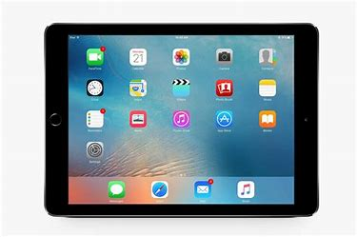
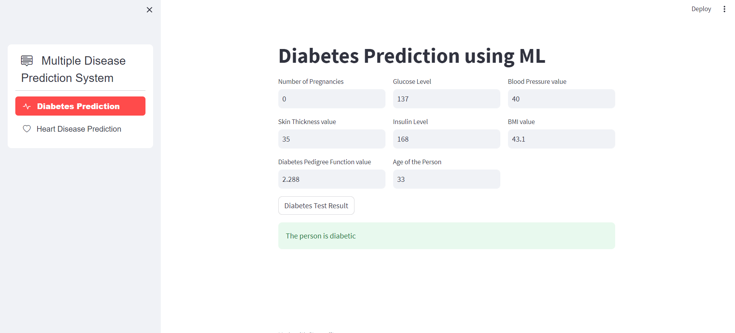
Project Overview

Slide 6
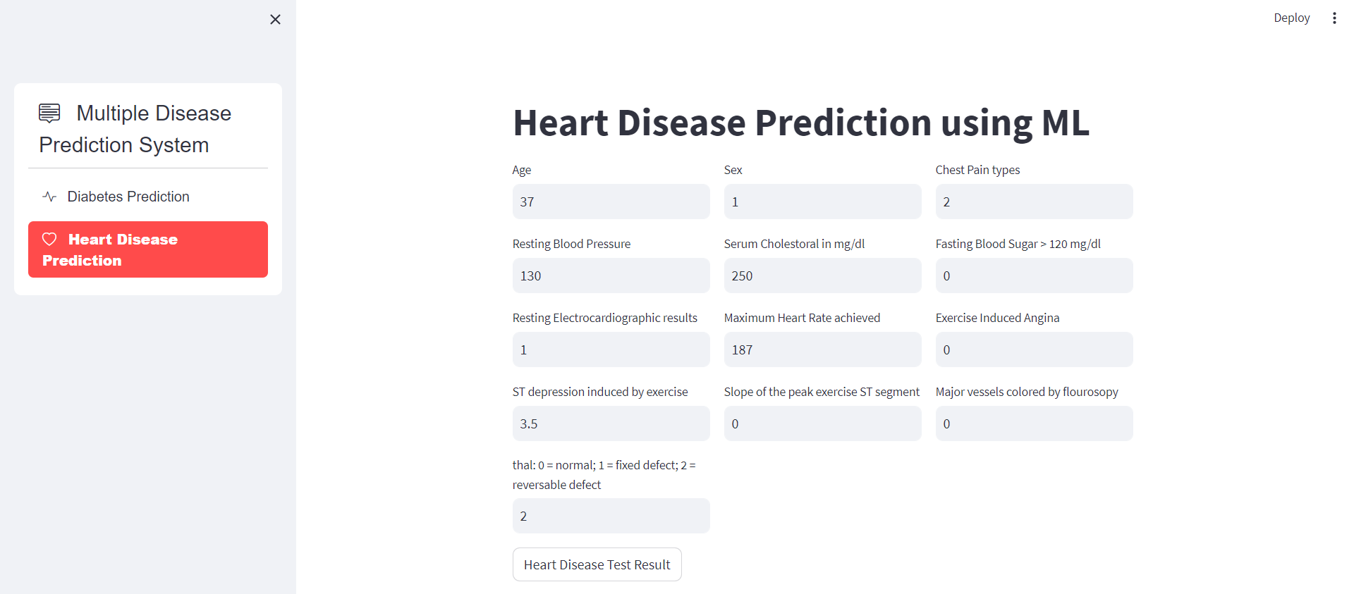
Project Overview

Slide 7
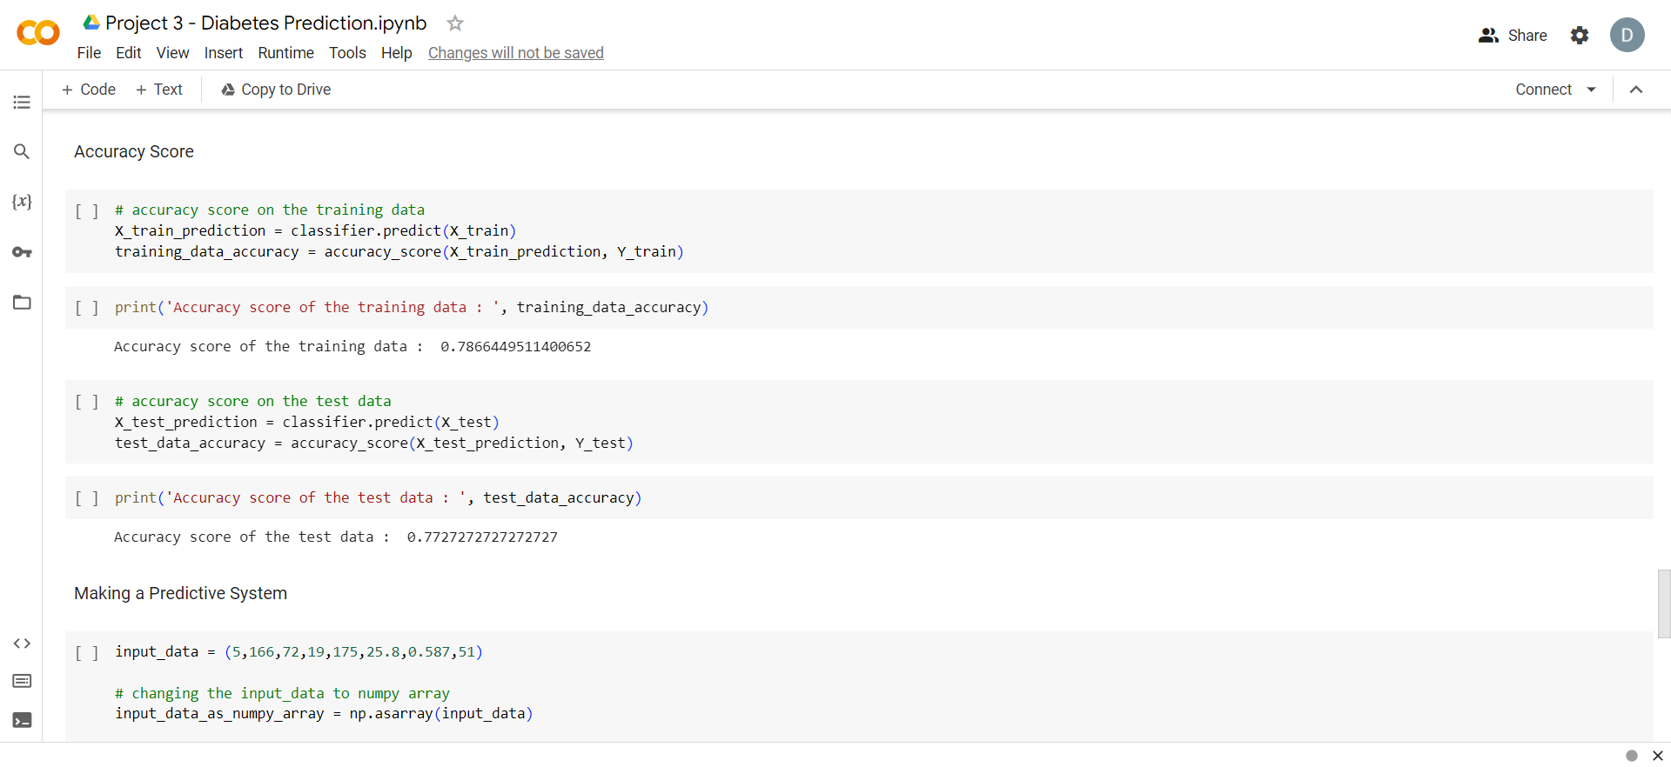
Codebase Preview

Slide 8
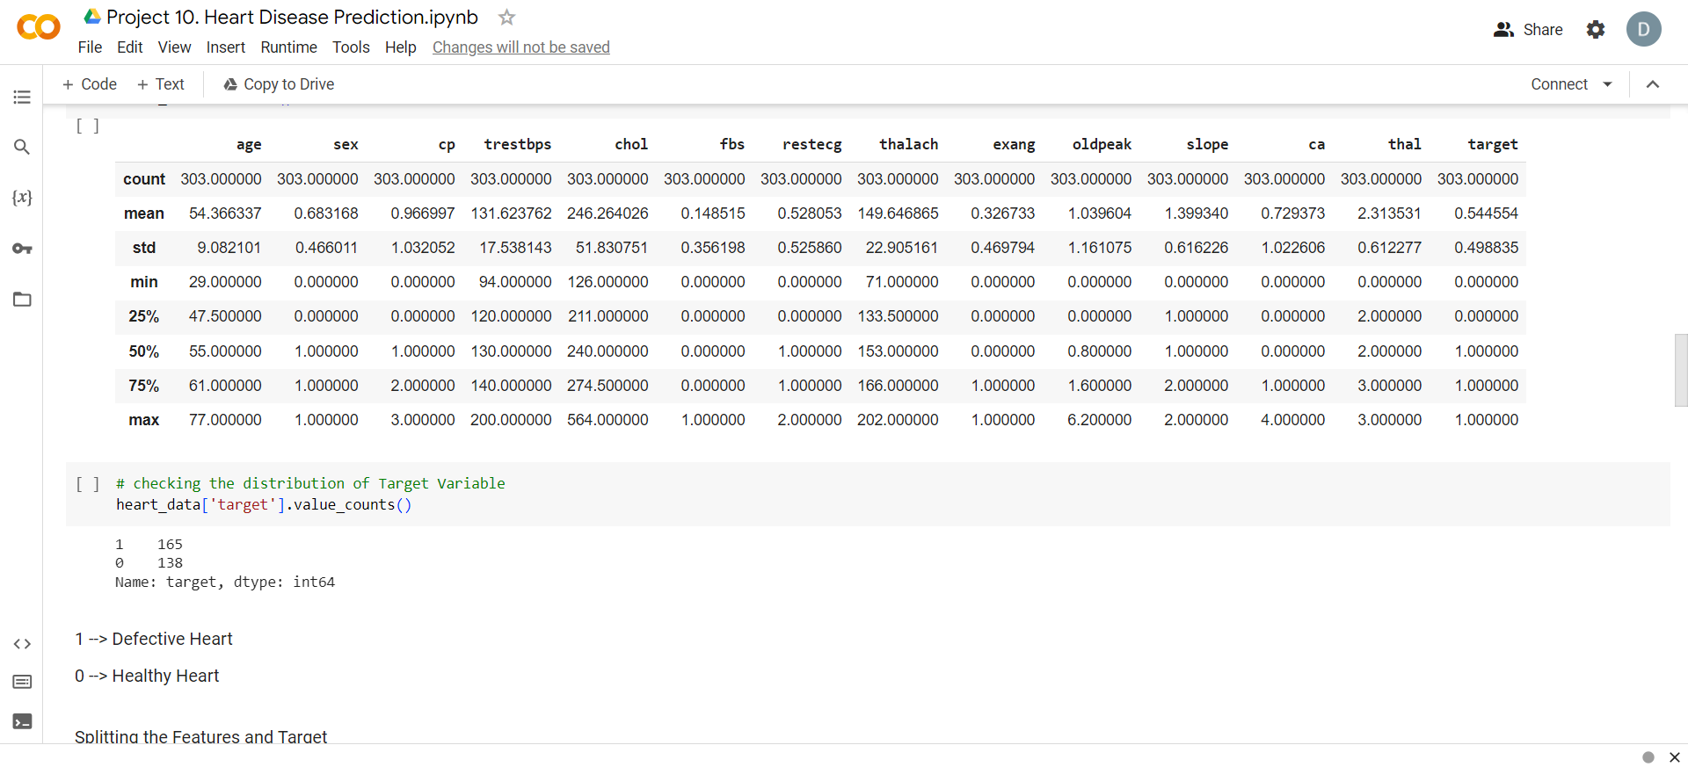
Codebase Preview

Slide 9
What technology is incorporated into this project?
NumPy, pandas, sklearn for creating models
Google Colab for creating notebooks
Streamlit for creating frontend and connecting with model
Figma for design and layout
VS Code IDE

Slide 10
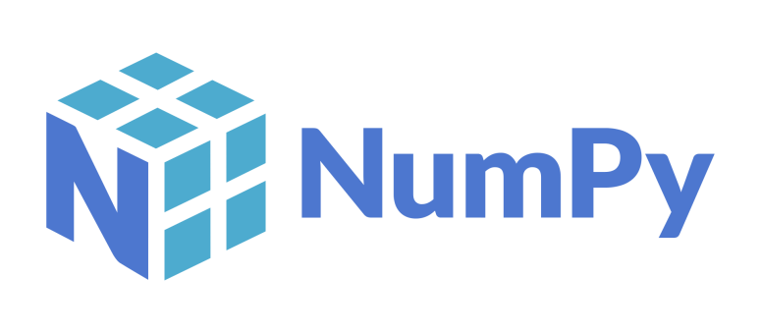
1.Arrays: NumPy provides the ‘ndarray’ for efficient storage and manipulation of arrays, which are homogeneous collections of elements with fixed sizes.
2.Efficient Operations: NumPy enables vectorized operations on arrays, avoiding the need for explicit loops and allowing for fast mathematical computations.
3.Linear Algebra: It includes functions for essential linear algebra operations like matrix multiplication, inversion, and decomposition.
4.Broadcasting: NumPy supports broadcasting, allowing operations on arrays of different shapes and sizes, making code more concise and readable.

Slide 11

High-Level Language: Python is a high-level, interpreted programming language known for its readability and simplicity. It emphasizes code readability and allows developers to express concepts in fewer lines of code than languages like C++ or Java.
Versatility: Python is a versatile language used in various domains, including web development, data science, machine learning, artificial intelligence, automation, and more. Its extensive standard library and third-party packages contribute to its versatility.
Interpreted and Dynamically Typed: Python is an interpreted language, meaning that code is executed line by line without the need for compilation. It is also dynamically typed, allowing developers to change variable types during runtime, providing flexibility but requiring careful attention to variable types.
Community and Ecosystem: Python has a large and active community of developers. The Python Package Index (PyPI) hosts a vast collection of third-party libraries and frameworks, contributing to a rich ecosystem that facilitates rapid development and problem-solving.

Slide 12

Cloud-Based Notebooks: Google Colab, short for Colaboratory, provides a free, cloud-based platform for creating and running Jupyter notebooks. It allows users to write and execute Python code directly in the browser without any setup.
Free GPU Access: Colab offers free access to Graphics Processing Units (GPUs) and Tensor Processing Units (TPUs), enabling users to accelerate computations for machine learning and data analysis tasks. This is particularly beneficial for training deep learning models.
Collaboration and Sharing: Users can easily share their Colab notebooks just like Google Docs or Sheets. It supports real-time collaboration, making it a useful tool for teamwork on coding projects or educational purposes.
Integration with Google Drive: Colab is integrated with Google Drive, allowing users to save their work directly to Drive. This feature simplifies version control and provides a convenient way to store and access Colab notebooks.

Slide 13

Rapid Prototyping: Streamlit is a Python library designed for creating web applications with minimal effort. It excels at rapid prototyping, allowing developers to turn data scripts into shareable web apps quickly.
Simplicity and Intuitiveness: Streamlit follows a simple and intuitive syntax, making it accessible to users with varying levels of programming experience. With just a few lines of code, you can create interactive and responsive web applications.
Data Visualization: Streamlit simplifies the process of integrating data visualizations into web apps. It works seamlessly with popular data science libraries like Matplotlib, Plotly, and Altair, allowing users to create charts and graphs effortlessly.
Widgets and Interactivity: Streamlit provides a variety of widgets (e.g., sliders, buttons, text inputs) that enable users to interact with and manipulate data in real-time. These widgets can be easily added to the app, enhancing the overall user experience.

Slide 14

Cloud-Based Design Collaboration: Figma is a cloud-based design tool that allows multiple users to collaborate on design projects in real-time. This facilitates seamless collaboration among designers, developers, and other stakeholders, regardless of their physical location.
Cross-Platform Compatibility: Figma is a cross-platform application that works on various operating systems, including Windows, macOS, and Linux. It enables designers to work on their projects using different devices with consistent user experiences.
Prototyping and Interaction Design: Figma goes beyond static design by offering prototyping features. Designers can create interactive prototypes with transitions and animations, providing a more dynamic representation of the user experience.
Component-Based Design: Figma promotes a component-based design approach, allowing designers to create reusable UI elements. Changes made to a component are automatically reflected wherever that component is used, streamlining the design process and ensuring consistency.

Slide 15
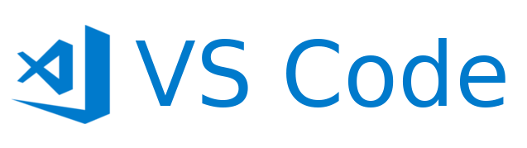
Free and Open Source: Visual Studio Code is a free and open-source code editor developed by Microsoft. It is widely used by developers across different platforms, including Windows, macOS, and Linux, making it accessible to a broad community.
Extensibility and Marketplace: VSCode is highly extensible, allowing users to enhance its functionality with a wide range of extensions. The Visual Studio Code Marketplace offers a vast collection of extensions, themes, and tools contributed by the community, enabling users to customize their development environment.
Intelligent Code Editing: VSCode provides features such as IntelliSense, which offers intelligent code completion, suggestions, and parameter hints. It also includes built-in support for various programming languages and file formats, making it a versatile choice for developers working on diverse projects.
Integrated Version Control: Version control is seamlessly integrated into VSCode through extensions like Git. Developers can manage repositories, commit changes, and review version history directly within the editor, streamlining collaboration and code management.

Slide 16
THANKYOU
Devanshi Bahuguna 2100910100065
Anushka Sharma 2100910100039
Bhavya Mittal 2100910100058
Aryan Chaturvedi 2100910100044

